Slide 1
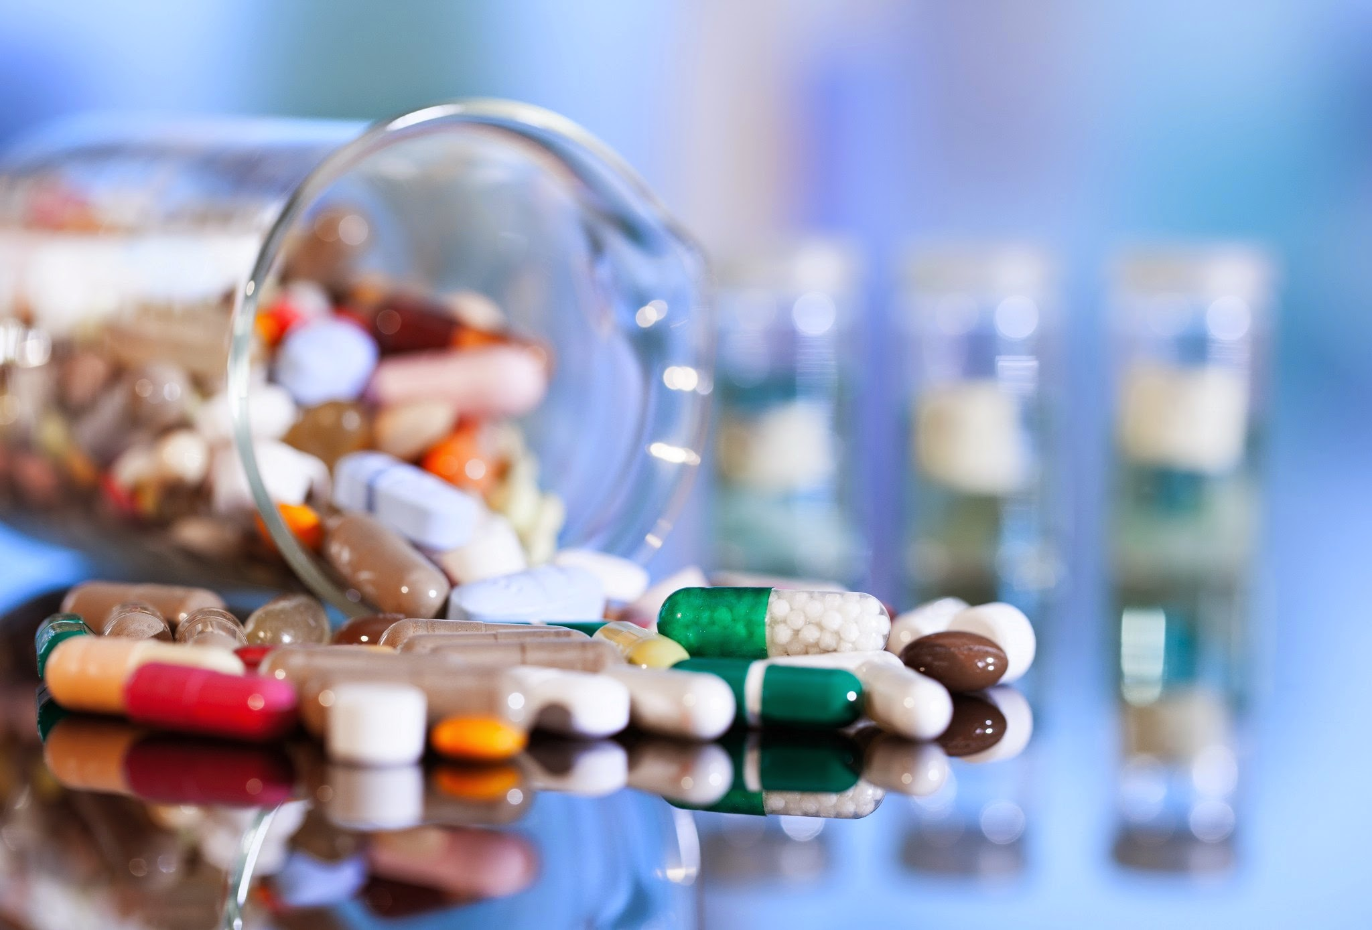
Predicting Clinical Trial Success
Pharma AI Team:
Sheri Shojaie
Vivianti Santosa
Momotaz Mahin Khan
Eben Haezer Saputra

Slide 2
Clinical Trials are risky and expensive investment
Phase 3
$20M
Phase 2
$13M
86 %
Overall Failure Rate of drugs and vaccine trial
Phase 1
$4M
Clinical Trial Cost of drugs and vaccine trial
Notes:
Cost source: https://www.sofpromed.com/how-much-does-a-clinical-trial-cost/#:~:text=The%20average%20cost%20of%20phase,median%20of%20%2441%2C117%20per%20patient
Failure rate: https://www.acsh.org/news/2020/06/11/clinical-trial-success-rates-phase-and-therapeutic-area-14845

Slide 3
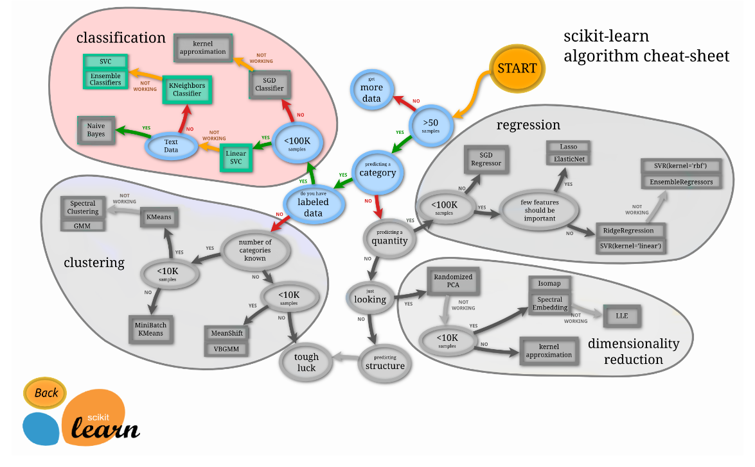
…Enter Machine Learning!
Can we predict which trial more likely to succeed?
Can we find factors affecting that clinical trial success rate?

Slide 4
Clinical Trials are risky and expensive investment
Notes:
Cost source: https://www.sofpromed.com/how-much-does-a-clinical-trial-cost/#:~:text=The%20average%20cost%20of%20phase,median%20of%20%2441%2C117%20per%20patient
Failure rate: https://www.acsh.org/news/2020/06/11/clinical-trial-success-rates-phase-and-therapeutic-area-14845

Slide 5
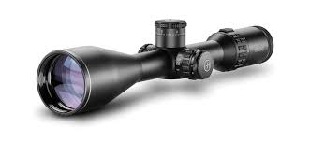
The process: 1. Scoping
Predicting success rate in Phase 2 only; safety only
Data from clinicaltrials.gov
Trials in United States only

Slide 6
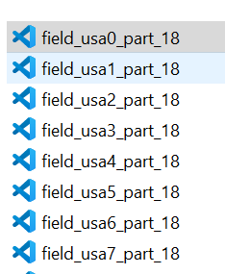

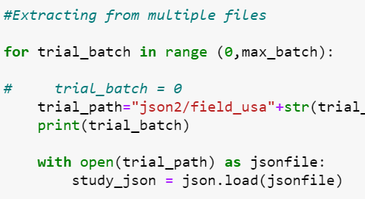
The process: 2. Data Extraction & Cleaning
API Extraction
Thousands of files
Auto Merging JSON
Combined into one 4GB of files

Slide 7
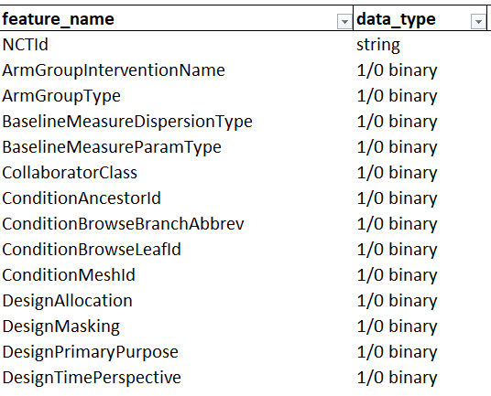
The process: 3. Transformation – Exclusion of Data
Feature Selection - Domain Knowledge Expert
300+ Features to 30

Slide 8
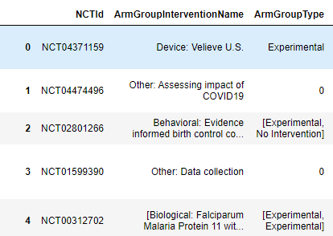
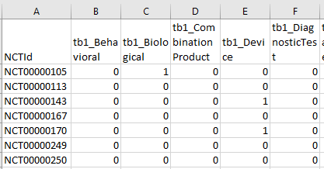
The process: 4. Transformation of data
Machine learning can only process numbers
Nested Categorical Data
One Hot Encoding

Slide 9


The process: 5. Loading the Data
AWS RDS for Database and PostgreSQL

Slide 10
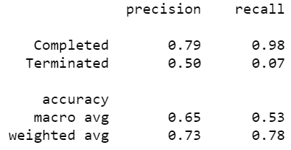
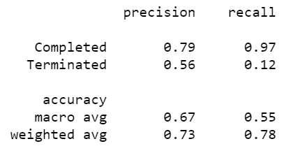
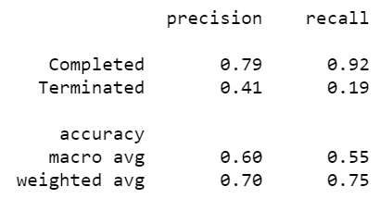

Result: The Calculation
Logistic Regression
Random Forest
K Nearest Neighbour

Slide 11
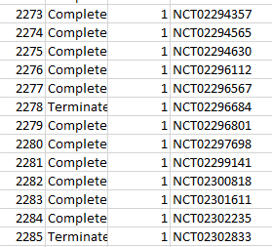
Result: Machine learning prediction of Ongoing trials

Slide 12
Result: Visualization
Click here for Tableau!

Slide 13
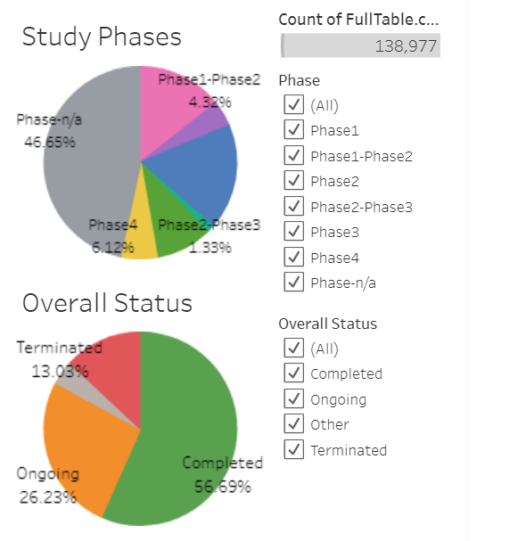
Visualization Result – part 1
Dashboard #1
Goal:
Give quick understanding of our data size
Show number of the data before, and after we apply filter
Show proportion of data (terminated, completed, etc)
Emphasize:
Number of Trials at current filter state (Count of FullTable)
Percentage of Overall Status
Everything else is not necessary at this point, I think?
Maybe use only small part of Dashboard3, but in bigger size

Slide 14
Visualization Result – part 2
Dashboard #2
Goal:
Show viz result of Random Forest, highlighting 6 chosen features
Allow user to navigate between different conditions, so they can compare
Thought:
Basically Dashboard4, but we use only data from Random Forest Prediction
Let’s make sure the middle part is not blank

